Slide 1
The Finite Element Method
Overview of Technique
Sample Element Library
Errors Associated with the technique
1D Truss Element
Direct Stiffness Method

Slide 2
One-Dimensional Truss Element: Direct Stiffness Development
y
f_{xi}
f_{xj}
u_{i}
u_{j}
x
i
j
x_{i}
L_{e}
x_{j}

Slide 3
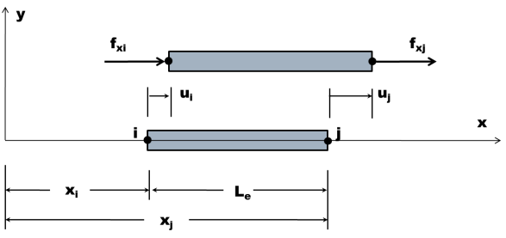
A Displacement Field is Assumed, u(x), nodal par.
Simplest Function for Displacement Field
One dimensional element
Two nodes
1
At the two nodal points u(x) can be written.
2
3
Notes:
The simplest function that can be assumed for the displacement function in terms of x and the nodal parameters.

Slide 4
The Displacement Functions are in Terms of u_{i} and u_{j}
2
3
1
Substituting and into
4
Shape Functions or
Interpolation Functions
Notes:
The simplest function that can be assumed for the displacement function in terms of x and the nodal parameters.

Slide 5
Shape Functions Critical To Element Development
4
1
N_{i}
0
x
i
j
1
N_{j}
0
x
i
j
Notes:
The simplest function that can be assumed for the displacement function in terms of x and the nodal parameters.

Slide 6
From Elasticity’s Strain-Displacement Relationship ε_{x}
Substituting in
4
5
[B] matrix
Notes:
The simplest function that can be assumed for the displacement function in terms of x and the nodal parameters.

Slide 7
From Elasticity’s Constitutive Relationship σ_{x}
Substituting in
5
6
Notes:
The simplest function that can be assumed for the displacement function in terms of x and the nodal parameters.

Slide 8
Stress Multiplied by Area gives Nodal Forces
The sign comes from the Convention that on a negative surface a tensile stress (and the force associated with it) will be directed in the negative coordinate direction
Substituting in
6
7
Notes:
The simplest function that can be assumed for the displacement function in terms of x and the nodal parameters.

Slide 9
The Stiffness Matrix Relates Forces and Displacements
7
[k]_{e} ≡ Stiffness Matrix
8
Notes:
The simplest function that can be assumed for the displacement function in terms of x and the nodal parameters.

Slide 10
A Summary of the Direct Stiffness Steps
Define
the displacements and loads associated with the degrees of freedom of the nodes
the geometry and material properties of the elements
Assume a deflection field of the element
as many unknowns as degrees of freedom
Determine the unknown constants in terms of nodal position and displacements
Differentiate the displacement field equations to obtain the strain as a function of nodal displacements
Substitute the stress-strain relations to write the stress as a function of nodal Displacement

